Slide 1

We making visible
Visual-assist Glasses

Slide 2
The goal of the user study
1, Navigation function
2, Obstacle and traffic detection
3, Life assisting function

Slide 3
Participants and apparatus
1, Participants chosen
• Select several personnel
• Both able-bodied and physically handicapped
• Be divided into different groups
• Signed an informed consent form
• Guaranteed that their privacy will not be leaked

Slide 4
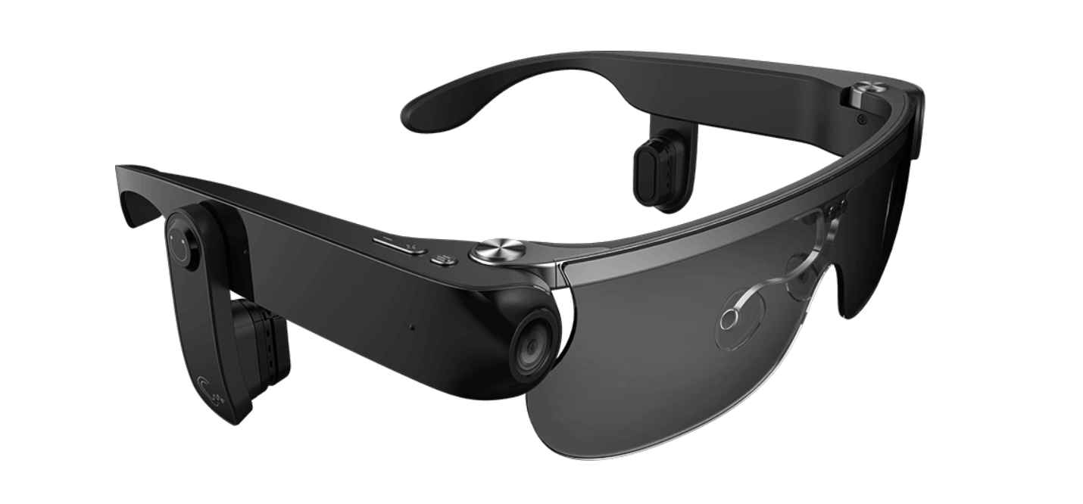
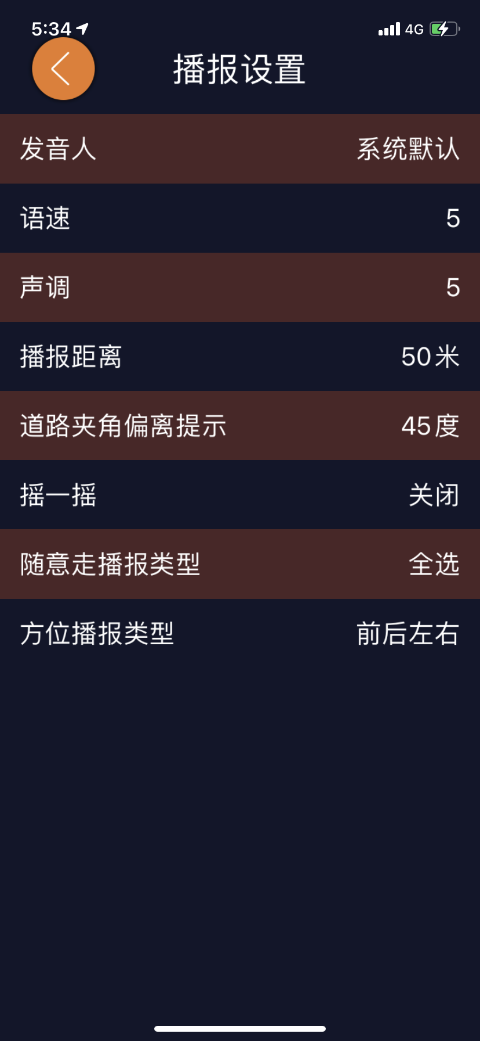
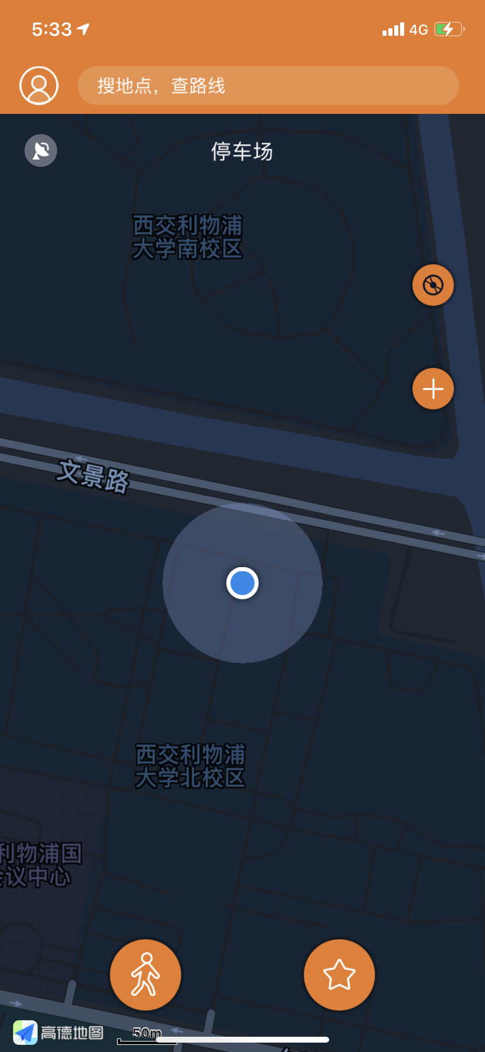
Participants and apparatus
2, Apparatus chosen
• Glasses
A Phone with matching app •
c

Slide 5
Procedure and evaluation method of user study
1, Navigation function
• Usability Evaluation
• Heuristic Evaluation
• Qualitative Evaluation
usability engineering approaches
record observations for analysis

Slide 6
Procedure and evaluation method of user study
2, Obstacle and traffic detection
• Usability Evaluation
• Quantitative Evaluation
no mistakes can be tolerated
mistakes mean accidents and injuries
• Heuristic Evaluation

Slide 7
Procedure and evaluation method of user study
3, Life assisting function
• Usability Evaluation
• Quantitative Evaluation
• Qualitative Evaluation
naturalistic approaches

Slide 8
Procedure and evaluation method of user study
4, Comprehensive user study
• Qualitative Evaluation
naturalistic approaches
test in naturalistic, complex environment
• Quantitative Evaluation
subjective opinions of people
• Heuristic Evaluation

Slide 9
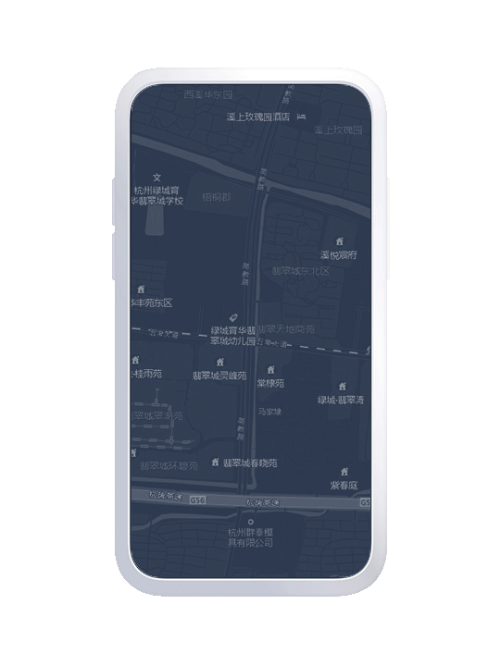

The expected result of …
Navigation function:
• App should plan the best route:
Fewer obstacles,
Shortest time,
Maximum safety:
blind track coverage,
less crossing the road …
• Glasses should give guidance:
Correct,
Timely …

Slide 10
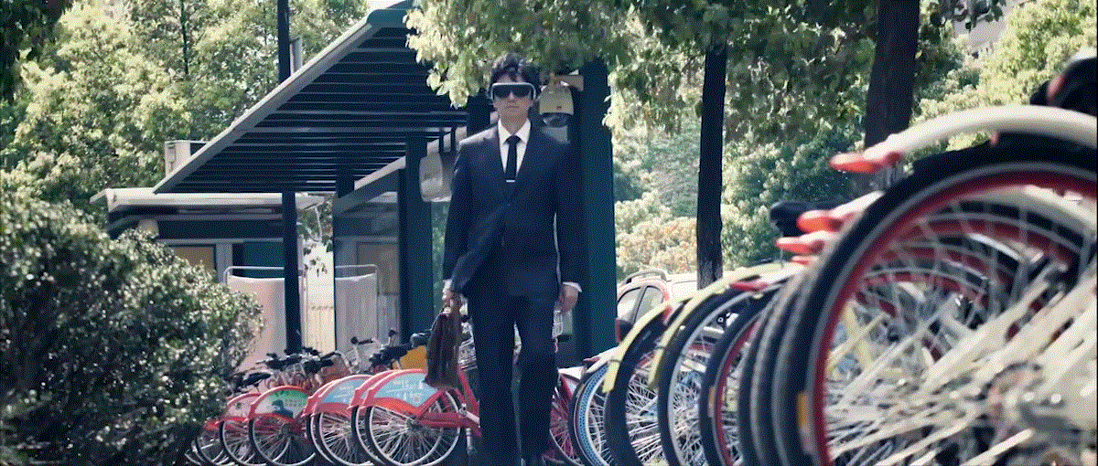
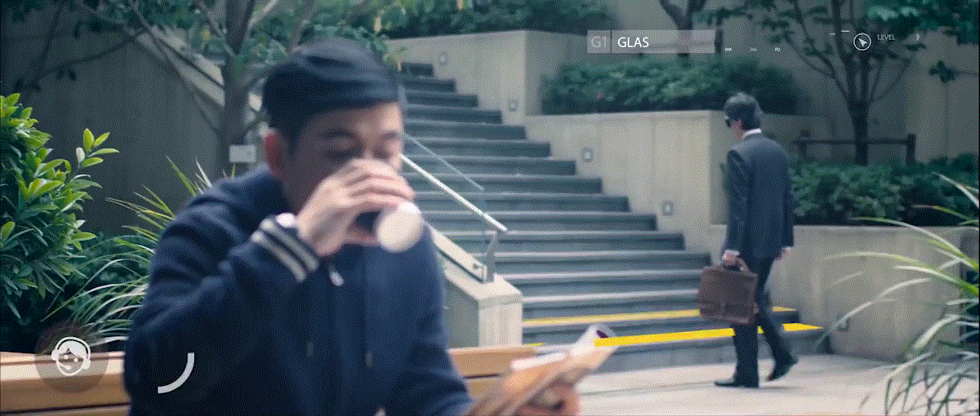
The expected result of …
Obstacle and traffic detection:
• Obstacle should be detected:
Steps,
Pits or open sewers in pavement …
• Condition of traffic should be detected:
Traffic light,
Nearby vehicle status,
Prohibited road section,
Zebra crossing …
• The error rate remains at low level:
Mistakes mean accidents and injuries …

Slide 11
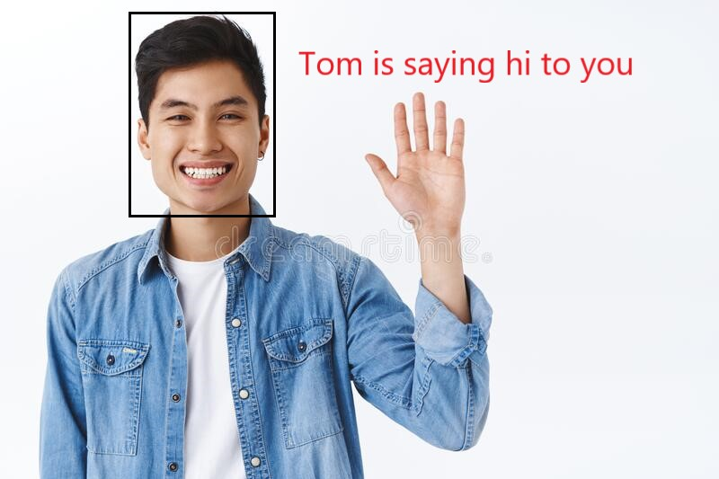

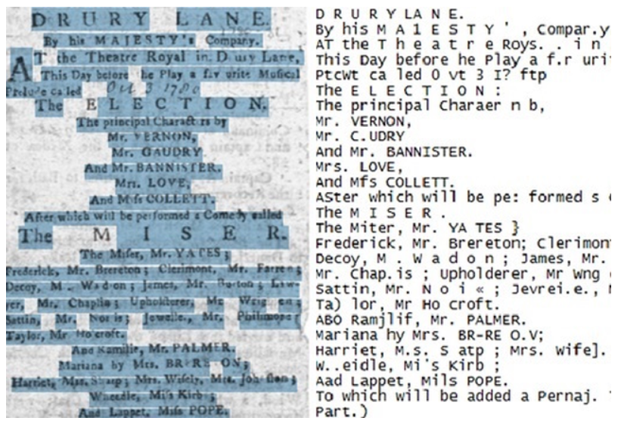
The expected result of …
Life assisting function:
• acquaintance recognition:
Glasses will recognize people and use voice to inform the user
• Reading/text recognition mode:
Glasses will recognize text and use voice to inform the user

Slide 12
Thank You
Team members
Lihan Zhao Xingbo Wei
Tianlei Shi
Zhichao Ma Hening Fan

